Slide 1
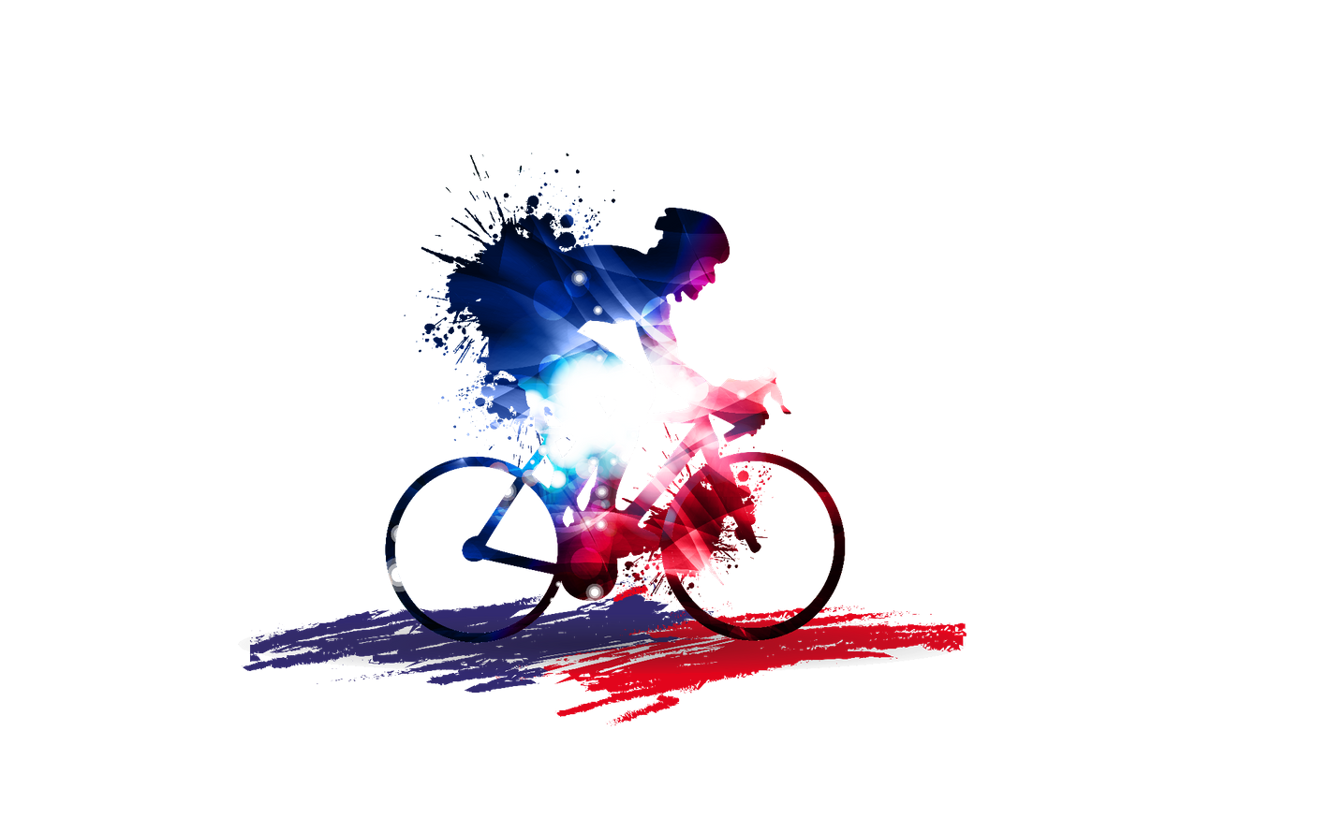



MEET & MATCH
INNOVATIVE AND CREATIVE FRENCH COMPANIES
of the sport sector looking for Dutch partners
(distribution partners, direct clients, retail players, agents, importers...)
FRANCE MEETS HOLLAND
SPORTS BUSINESS CENTER LEUSDEN
Thursday 4th July 2019
Address: Plesmanstraat 1, Leusden
Sign-up contact: edouard.vanderhaas@businessfrance.fr

Slide 2
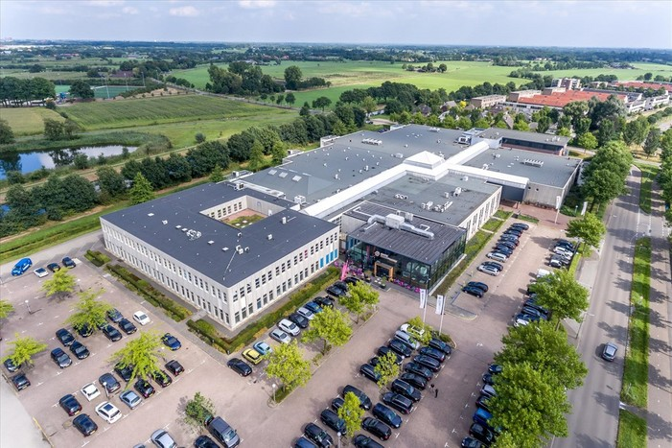
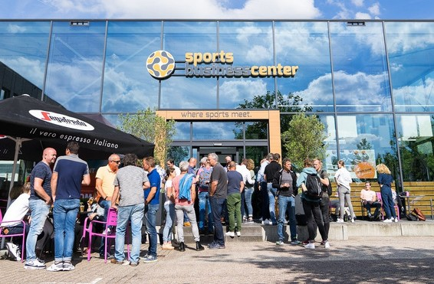

MEET & MATCH
The meetings will be held in the Sports Business Center Leusden, beating hart of the Dutch sport sector, and headquarters of the FGHS : Dutch branch organization for manufactures, wholesalers, subsidaries, importers, distributors and agents focused on the sport sector
09:30-10.00 : COFFEE & WELCOME
10:00-10.30 : PRESENTATION OF THE DUTCH SPORTING GOODS MARKET
10:30 - 12:30 : B2B MEETINGS
12:30-13:00 : LUNCH
13:00-17:00: B2B MEETINGS
Address : Plesmanstraat 1,
3833 LA Leusden Free parking
Sign-up contact: edouard.vanderhaas@businessfrance.fr

Slide 3

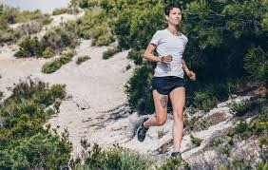

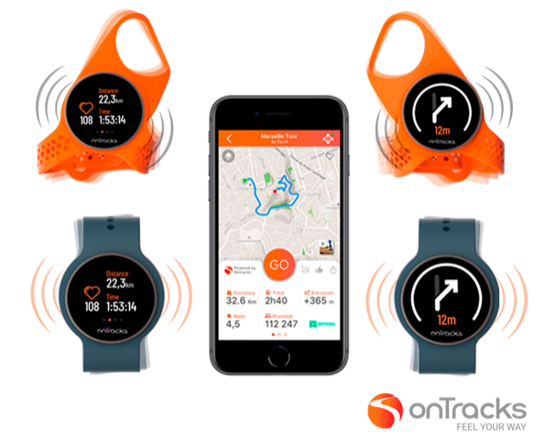
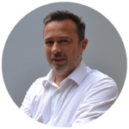

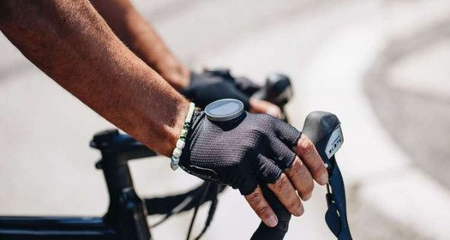
onTracks, the intuitive GPS for active people.
Who hasn’t wanted to roam around an area on a bike or explore a city while jogging? But at every intersection, you wonder whether you should turn left or right. You take out your map or phone to figure out where you are, try to remember intersections, get lost… It’s complicated.
With onTracks, you don’t need to look for information, it comes to you intuitively. Choose a track on your phone, put on your two Guidewathes - one at each wrist- and you're off ! When you need to turn right, your right-hand GuideWatch vibrates, and when you need to turn left, it’s the one on the left that vibrates.
With onTracks, feel your way !
PHILIPPE LECA
CEO
PLECA@ONTRACKS.CO M: +33 6 50 05 53 47
WWW.ONTRACKS.CO

Slide 4

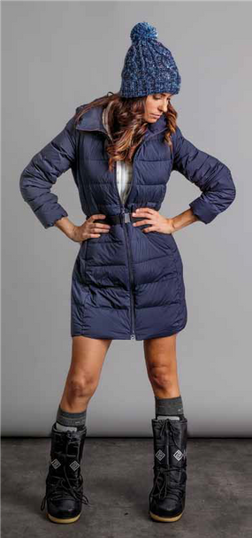
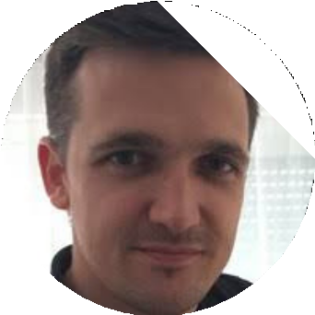
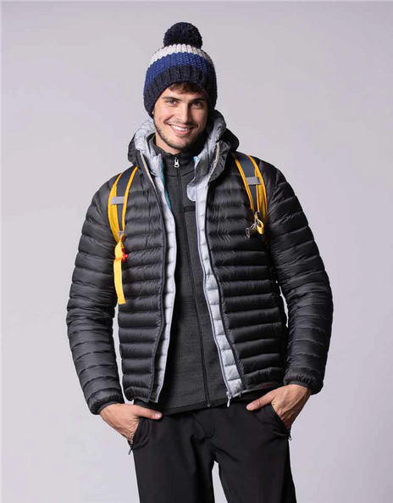
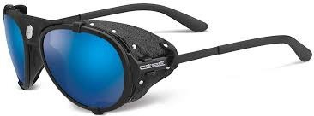
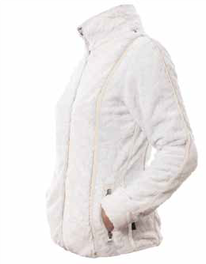

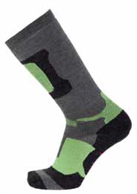
Innovator in the accessories and sportswear market,
Groupe Eurosports Diffusion, based near Grenoble, has 1 500 customers around Europe (physical stores and online resellers) with its brand LHOTSE 8516m. LHOTSE 8516m focus itself on all consumers looking for a complete range of sport gear & sportswear (clothing, shoes and accessories for outdoor activities, but also mountain and trail equipment...) at an affordable price, guaranteeing the best value and quality. Our group and brand has been growing for the past years now thanks to:
The quality and price positionning of our collections
Our commercial policy proving a good margin for all our resellers
Our supply flexibility and reactivity thanks to our 3000m² warehouse in the Alps from where we ship to our customers.
DAVID DOUILLET
COMMERCIAL DIRECTOR
D.DOUILLET@LHOTSE.EU.COM M: +33 7 71 93 55 70
FR.EUROSPORTSDIFFUSION.COM

Slide 5


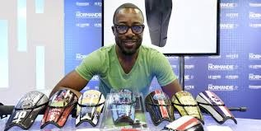

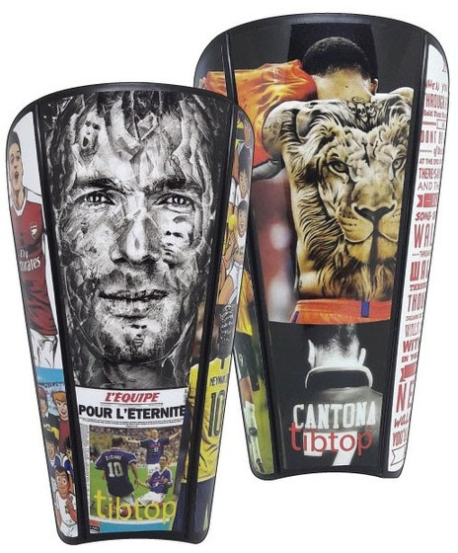
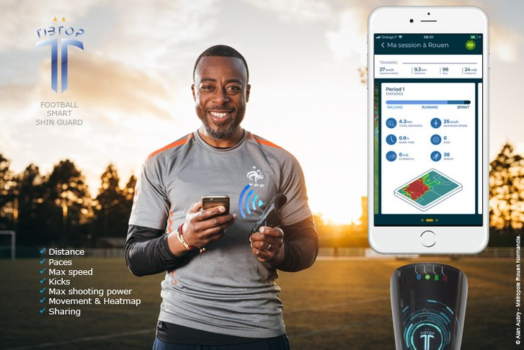
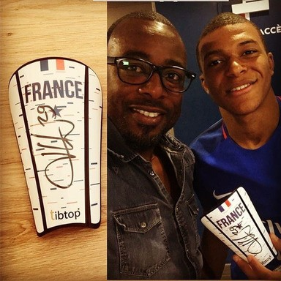
VBKAM is specialised in the production and distribution of connected Tibtop® shin guard supports,
protected by French patent and Community Trade Mark. All VBKAM activities - production and controls, assembly, costumisation, dispatch - are made in France.
Through VBKAM, Tibtop is today “storming” the market for technology-based equipment targeted at sportspeople who play football by equipping shin guards with intelligent, high performance electronic components that allow the user (amateurs or professionals) to assess and analyse their performance and skills in a serious and reliable way. Through the development of new services that deploy new Big Data technologies, VBKAM enables players to monitor their progression in a precise and accurate way (distance, pace, number of sprints, max speed, number of touches, shooting power, effective playing time..) or to compare their sporting abilities with those of great players or their friends via a mobile application. This world-wide innovation will help amateurs and professionals to improve and optimise their training and playing level in a safe and smart way.
BAKARY KAMARA
CEO
BKAM@MYTIBTOP.COM M: +33 6 89 15 26 76
WWW.MYTIBTOP.COM

Slide 6

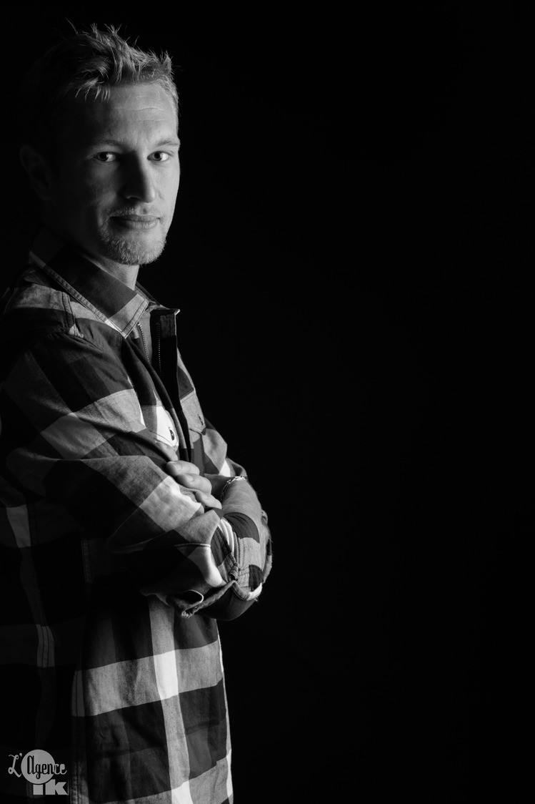
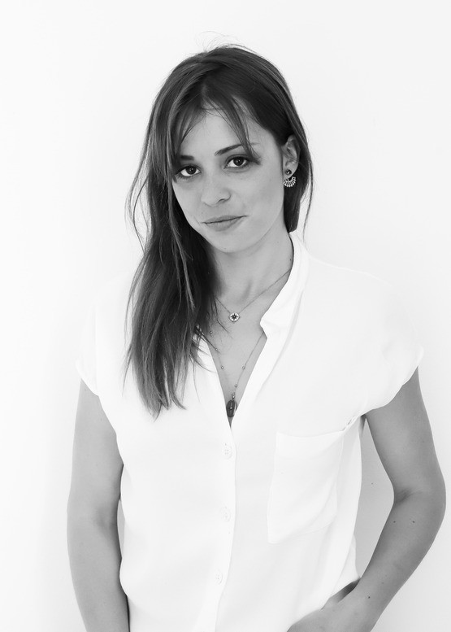
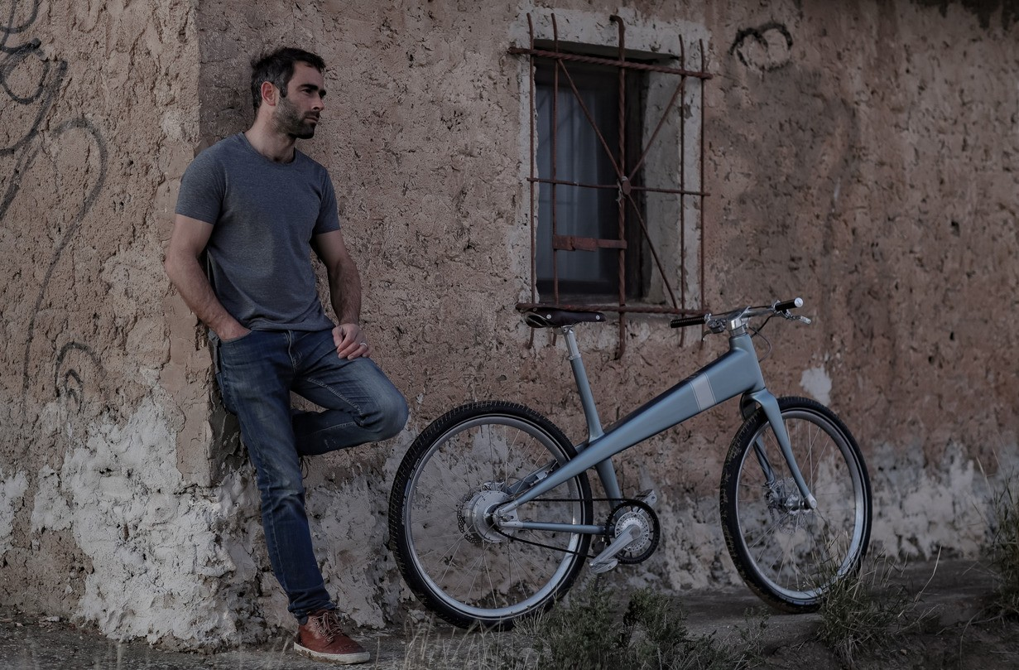
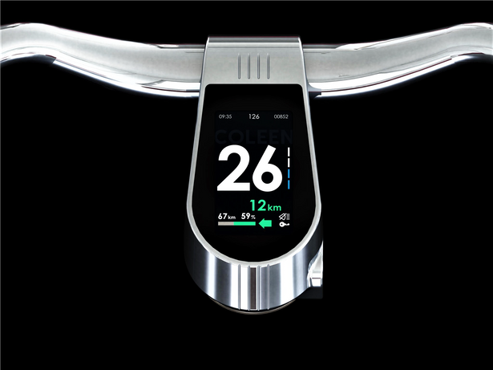
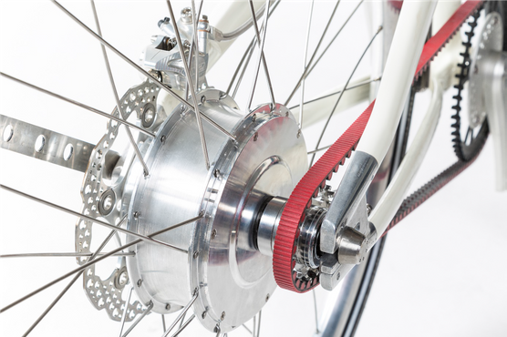
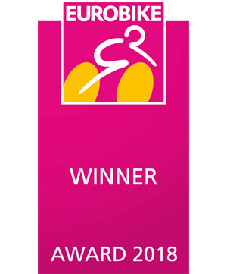
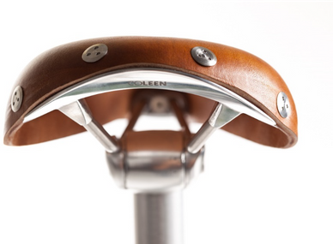
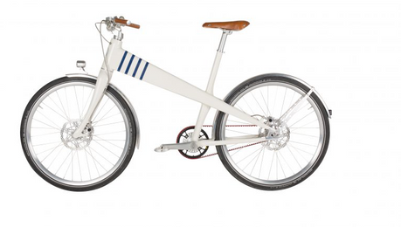

COLLEEN is a timeless iconic e-bike that appeals equally to men and women.
With the best weight/power ratio of the market, Coleen has created an exceptional e-bike designed to reinvent the pleasure of urban travel. Designed and manufactured in France, Coleen has taken up the challenge of bringing lightweight together with premium quality to create a product for those who love vintage style, design purists and everyone who appreciates beautiful machinery and groundbreaking technology. The frame geometry takes its inspiration from that of the first ‘dandy-horses’invented near the Avenue de Montaigne in Paris in 1861. Coleen has developed and perfected its own technical components to deliver on its promise of sustainable, safe urban mobility.
Main advantages and achievements :
A diruptive design, tested and made in france / a very light unisex model (18 kg)
A high capacity battery (100 km of autonomy after a max. of 2,5 hour charge)
Toplevel smart solutions : GPS tracking, High definition sunlight proof display, USB Port, Bluetooth connected to smartphone, Geolocalisation of parking, Automatic battery lock, Automatic light....
THIBAULT HALM / AUDREY LEFORT
CO-FOUNDERS
THIBAULT@COLEE-FRANCE.COM AUDREY@COLEEN-FRANCE.COM M: +33 6 86 28 12 22
WWW.COLEEN-FRANCE.COM

Slide 7

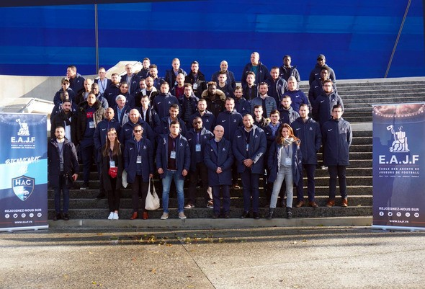
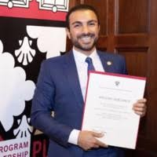
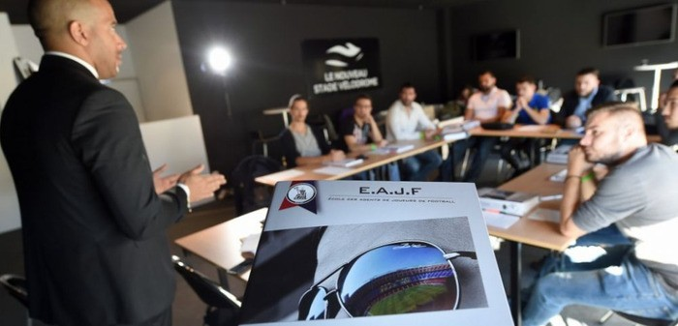

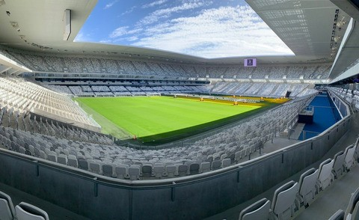
First European school for football players' agents
Context : FIFA will be reintroducing an examination for football agents by 2020. Registered "intermediaries" following deregulation will have to pass a new exam in all FIFA registered countries.
Since 2009, the E.A.J.F (School of the Football Players’Agents) has trained sports agents every year, who are able to understand the sporting and socio-economic challenges of soccer. The pedagogical model of E.A.J.F, based on the aquisition of theory as well as the practical side of the profession, has continued to evolve, today becoming the point of reference in France. Hosting the majority of candidates for the sports agent exam provided by the French Football Federation, the school is now established within the stadiums of several French Ligue 1 clubs: PSG, Lille, Lyon, Marseille, Bordeaux and Nantes.
EAJF is today using its 10 year experience in France to expend its knowledge and open schools in the UK, Spain, Italy, Belgium and the Neherlands. Therefore, EAJF is currentely in discussion with local partners : institutional partners as a first step (Football federation, University cooperation, player syndicates) & commercial partners as a second step.
ANTONY ZOUZOUT
COMMERCIAL DIRECTOR
ANTONY@EAJF.FR M: +31 1 80 88 8 07
WWW.EAJF.FR

Slide 8

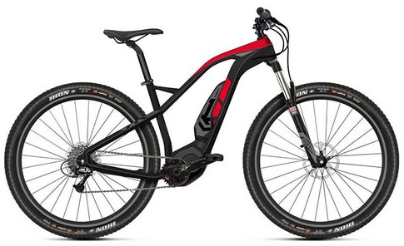
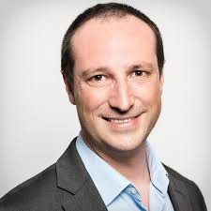
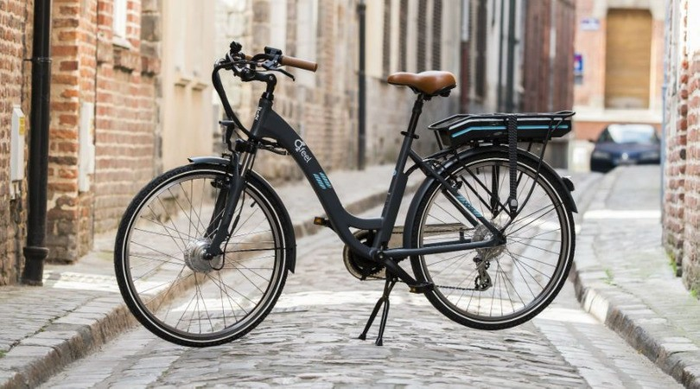
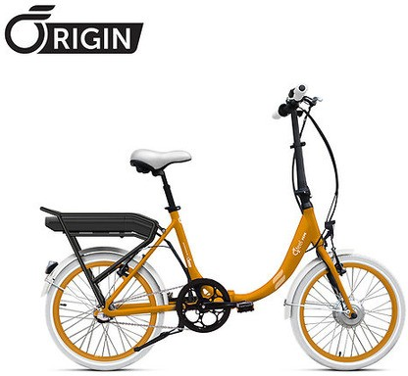
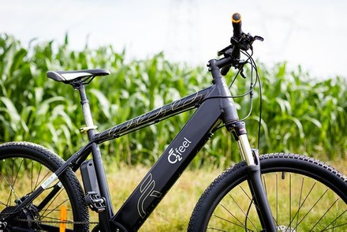
O2Feel is a French e-bike brand based in the North of France (Lille).
Since its start it has grown to a 2018 sales total of 15,000 e-bikes and about 15 million euro turnover. To further strengthen that growth the company is today growing on an international level. The company has its logistics center where a maximum of 10,000 e-bikes can be stored and shipped to customers all around Europe.
O2FEEL equips its e-bikes with Shimano components. In particular with STEPS mid-motors as well as batteries providing ranges up to 160 kilometers in the ECO mode. The 2019 O2Feel line-up includes the e-MTB Karma range, starting at 2,499 euro with a Shimano E7000 mid-motor, a 500Wh battery and Sram's Boost technology. The most ‘economic’ O2Feel e-bike is equipped with a STEPS mid-motor and comes at 1,899 euro retail.
O2FEEL is distributed in Europe in a total of 300 stores. It is well settled in Belgium with more than 50 stores, and is know penetrating the Dutch market in 5 first stores in Zeeland, Rotterdam, The Hague, Eindhoven and Badhoevedorp.
ANTONY LEPOUTRE
EXPORT DIRECTOR
A.LEPOUTRE@O2FEEL.COM M: +31 6 66 12 08 39
WWW.O2FEEL.COM

Slide 9

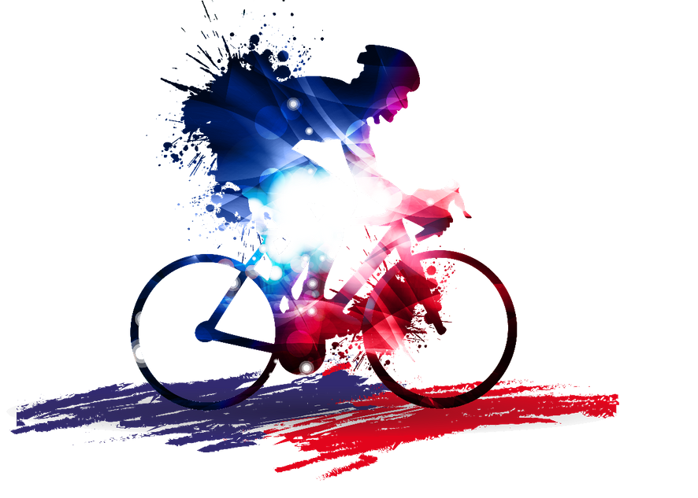


SIGN-UP CONTACT & MAIN PARTNERS OF THE EVENT
Interested in meeting one or several French companies ?
Please contact Edouard van der Haas and point out the profiles you would like to meet, and give us your availibility preference on july 4th :
Email : edouard.vanderhaas@businessfrance.fr
Business France, Trade department of the French Embassy in The Netherlands Tel : +31 (0) 20 794 19 69 / M : +31 (0) 6 41 02 83 71
Main partners of the event :
FGHS, www.fghs.nl
Dutch branch organization for manufactures, wholesalers, subsidaries, importers, distributors and agents focused on the sport sector
Dirk Vinken, Director, vinken@fghs.nl
Bonus for all Dutch companies interested in meeting a French profile :
A FREE ENTRANCE BADGE FOR THE "VILLAGE DE DEPART" OF THE TOUR DE FRANCE IN BRUSSELS ON SATURDAY 6TH OF JULY.
ORANGE SPORTS FORUM, www.orangesportsforum.com
Dutch national platform for the promotion of companies, organisations and institutions of the sports market. Connection platform to the Global Sports Industry
Camil Smeulders, Director, c.smeulders@orangesportsforum.com
BE APART OF THE FIRST STAGE OF THE TOUR DE FRANCE : AN OUT-AND-BACK RACE IN BRUSSELS !

